Slide 1

Zarr
A Storage Format for Chunked, Compressed ND-Array
@ PyCon DE & PyData Berlin 2023 🇩🇪
~Sanket Verma

Slide 2


About Me
~ Takes care of the community & OSS @ Zarr
~ Chair @ PyData Delhi and Global ‘20 & ‘21
~ Worked with forensics, startups, organisations
~ Sometimes I play the Violin
/msankeys963
Notes:
Tell about yourself.

Slide 3

Slides and code 👇🏻

Slide 4


What I’m gonna show you?
What is Zarr? How Zarr works?
Some Code
Why and When to use Zarr?
How Zarr is different?
What is the Zarr specification?
Zarr Implementations
Zarr Community & Future Goals

Slide 5


Inception of Zarr! 👶
~ Created by Alistair Miles (Oxford Geneticist; @alimanfoo) in 2015
~ Rapidly growing user-base and industry ready
~ Currently has 21 core-devs for Zarr-Python
~ Fiscally sponsored by NumFOCUS
~ Funded by CZI under EOSS
/zarr_dev /zarr-developers https://zarr.dev/

Slide 6
What is an array?
Before Zarr, let’s have a look at what array/tensor is?

Slide 7
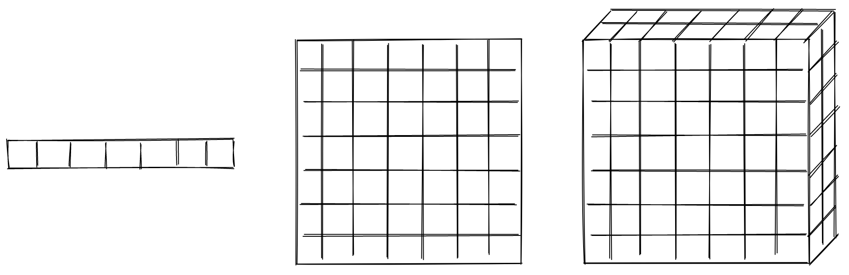
What is an array/tensor?
A container of items
Credits: Trevor Manz (@trevmanz)

Slide 8
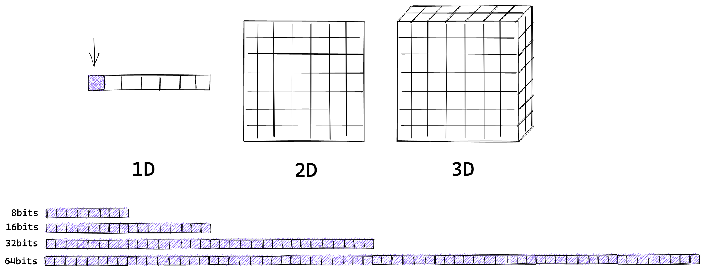
What is an array/tensor?
A container of items of the same data-type and size (in bits)
Credits: Trevor Manz (@trevmanz)

Slide 9
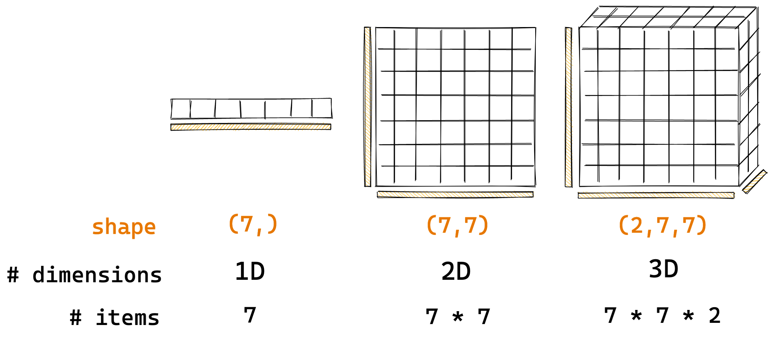
What is an array/tensor?
The number of dimensions and items in container are described by the shape
Credits: Trevor Manz (@trevmanz)

Slide 10

What is Zarr?
Zarr is open-source specification format for storing chunked, compressed, N-dimensional arrays.

Slide 11
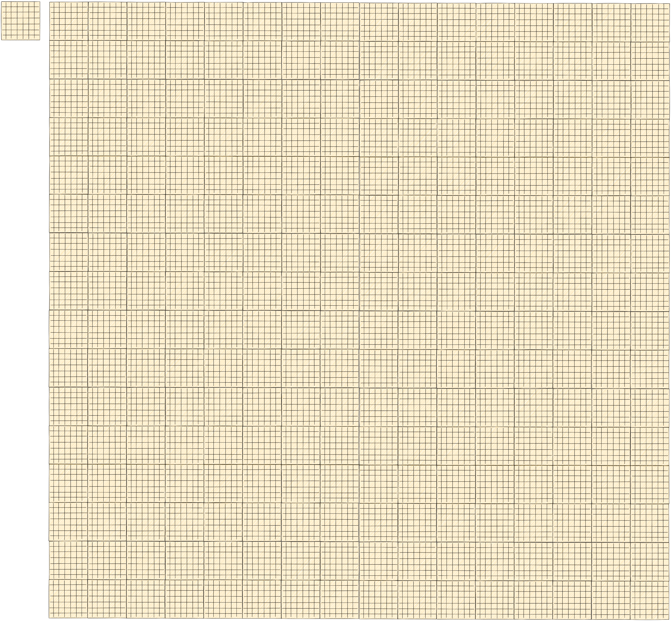
How Zarr works? 🤔
Credits: Trevor Manz (@trevmanz)

Slide 12
How Zarr works? 🤔
What if the data is too big to fit in memory

Slide 13
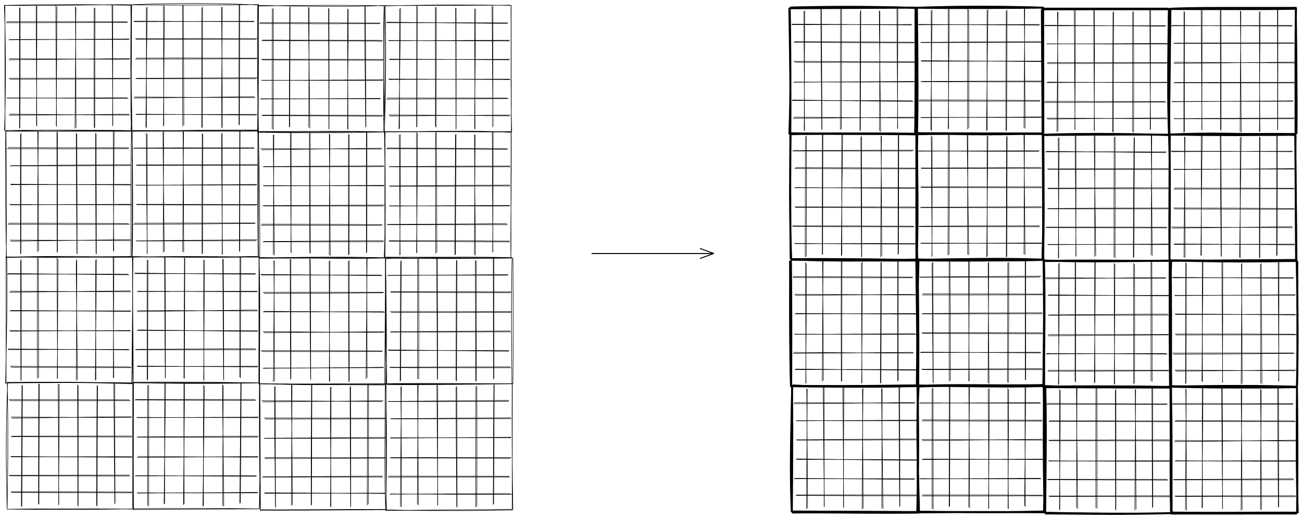
How Zarr works? 🤔
Divide array into chunks
Credits: Trevor Manz (@trevmanz)

Slide 14
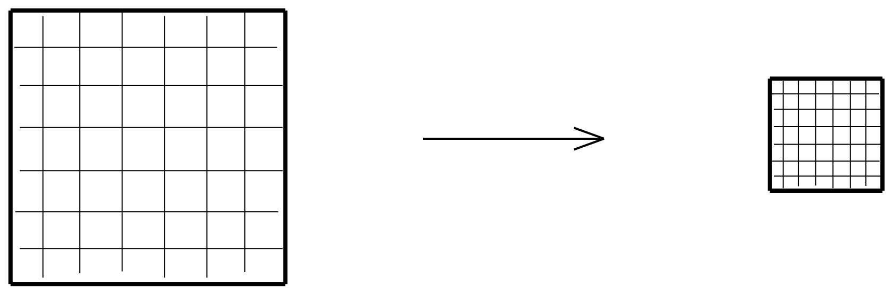
How Zarr works? 🤔
Compress each chunk Over 20 supported compressors (BLOSC, Zstd, Zlib, etc) https://numcodecs.readthedocs.io/en/stable/
Credits: Trevor Manz (@trevmanz)

Slide 15
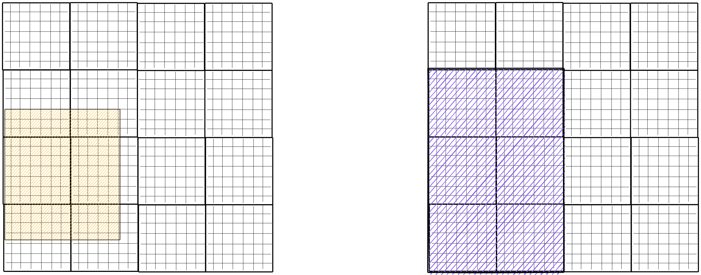
How Zarr works? 🤔
Retrieve chunks only when needed
Credits: Trevor Manz (@trevmanz)

Slide 16
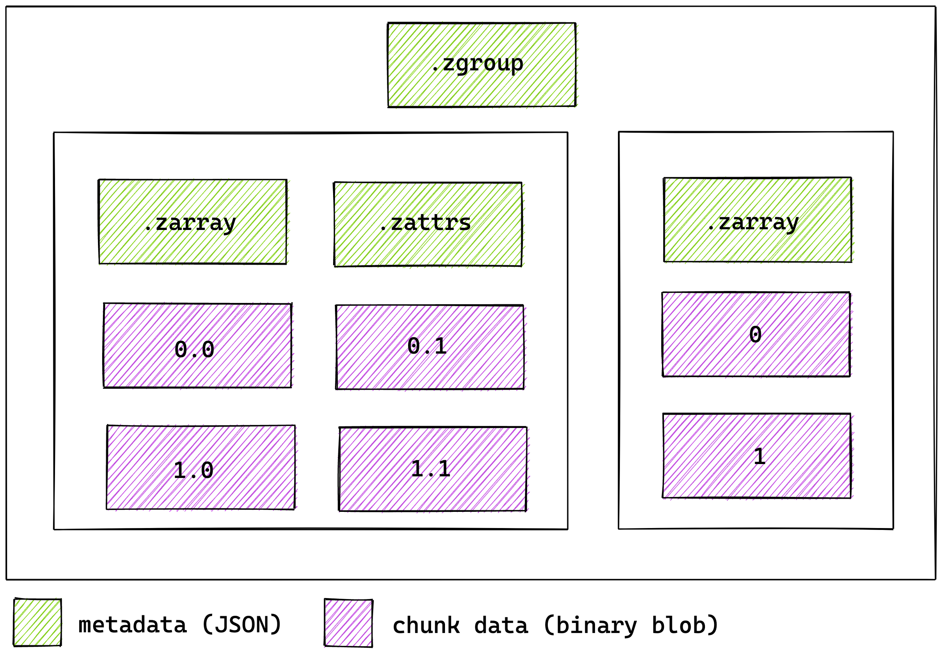
How Zarr works? 🤔
Multiple arrays can be organized in hierarchies of groups

Slide 17
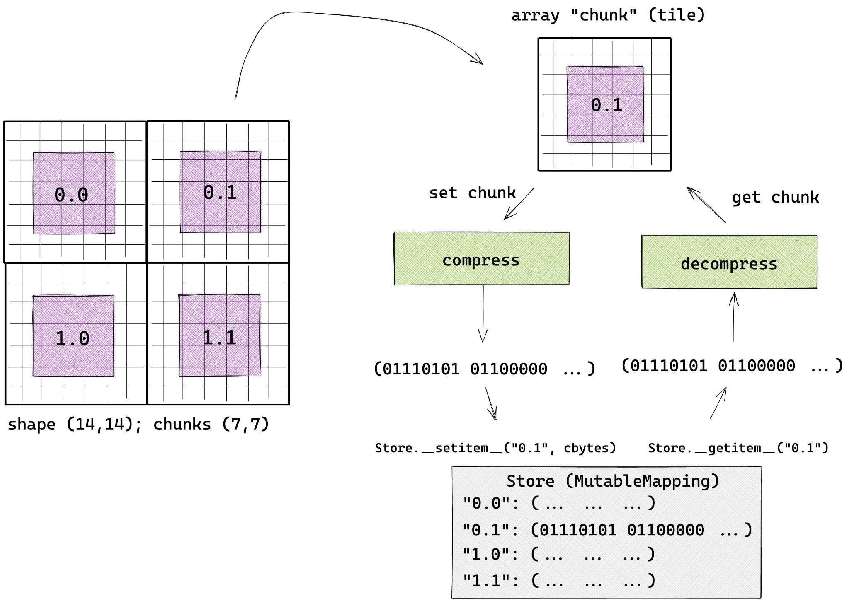
How Zarr works? 🤔

Slide 18
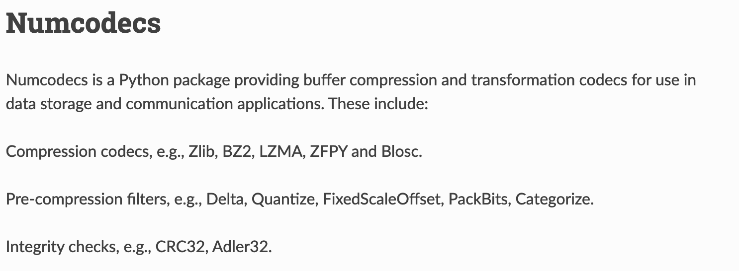
Compressors and File Storage in Zarr-Python 🗜️
(https://numcodecs.readthedocs.io/en/stable/)

Slide 19
Compressors and File Storage in Zarr-Python 🗜️
~ Over 12+ file storage system supported in Zarr-Python
~ Any object implementing the MutableMapping interface from the collections module in Python can be used as a Zarr array store
~ Can read and write to Amazon S3, GCS, HDFS and Azure Cloud storage

Slide 20

Let’s see some code! 🧑🏻‍💻

Slide 21

Documentation 📖

Slide 22
Why use Zarr? 🤓
~ Chunk arrays along any dimension
~ Arrays can be read & written concurrently from multiple threads/processes
~ Easy to extend, append, etc.
~ Extensive compression support + easy to plug-in new compressors
~ Support local and cloud storage systems (any key-value store)
~ Simple and based on open specification which allows it to be hackable!
Notes:
Mention the benefits of chunking!

Slide 23
When to use Zarr? 🤓
~ When you have absurdly large datasets!
~ When you want to share big datasets across multiple points (having key-valued chunks really helps this)
~ If you’re looking for a transparent OS data format with an awesome community!
~ And, to be cool among your friends and colleagues! 😎

Slide 24
How Zarr is different? 🤔

Slide 25
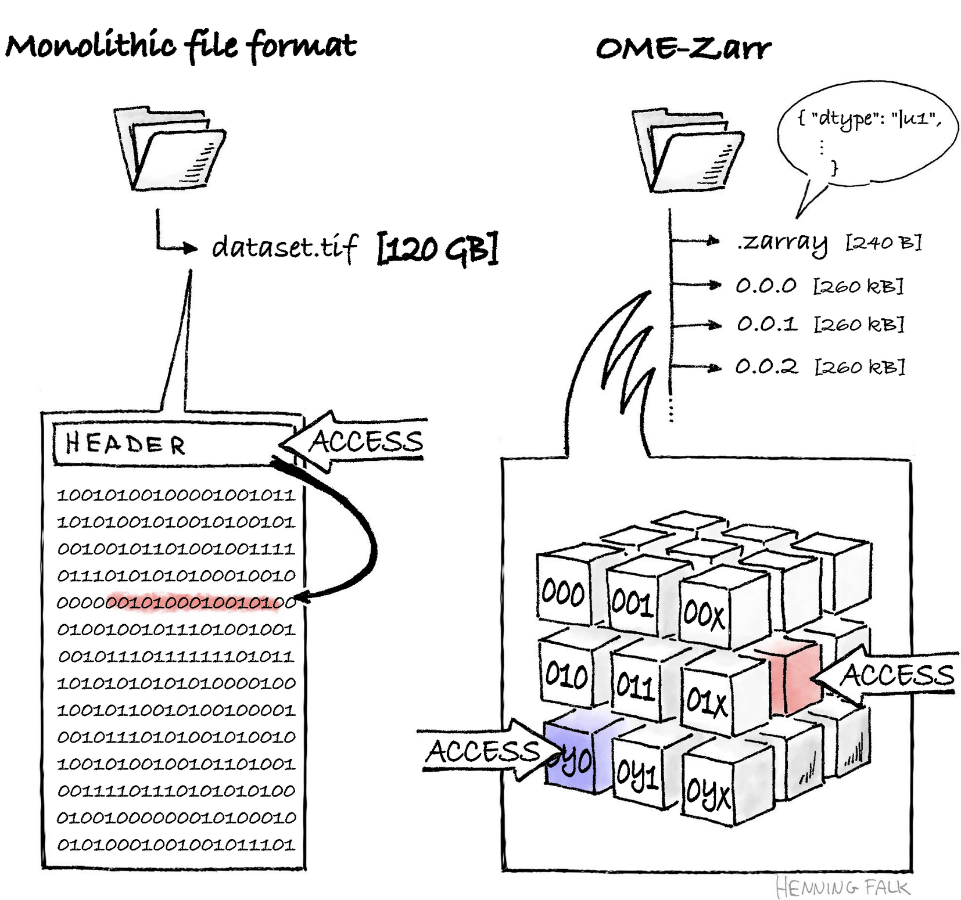

Slide 26


Slide 27
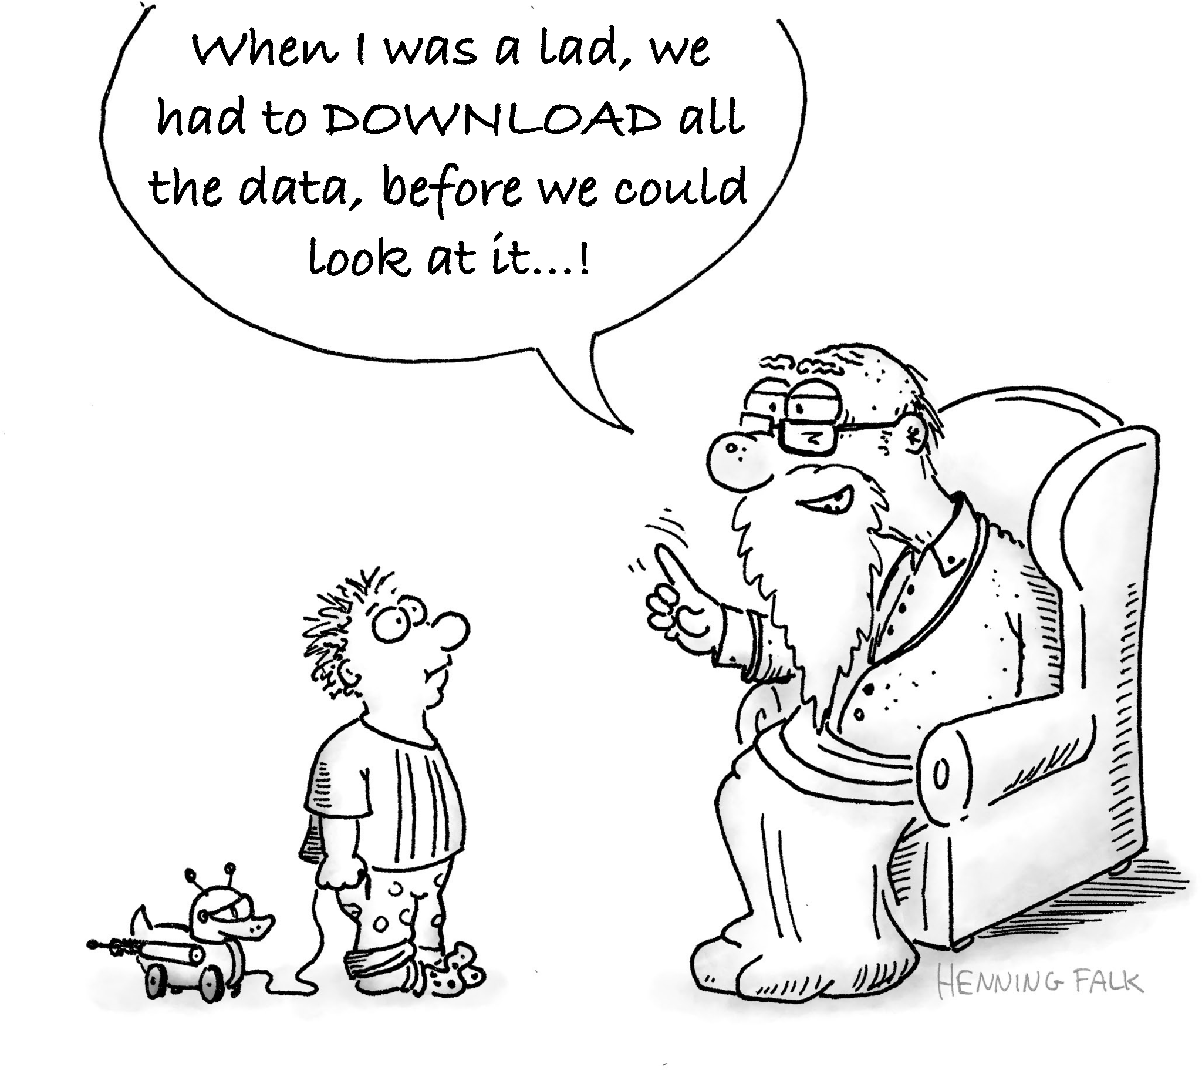

Slide 28

More illustrations 👇🏻

Slide 29
The Zarr Specification 🧐
~ Provides a technical specification of the protocol and format for storing Zarr arrays
~ Currently V2 is in effect
~ Tells how hierarchies are organised, arrays are chunked and grouped, how metadata should look like etc.
~ V3 is coming out very soon, see ZEP0001
https://zarr-specs.readthedocs.io/

Slide 30
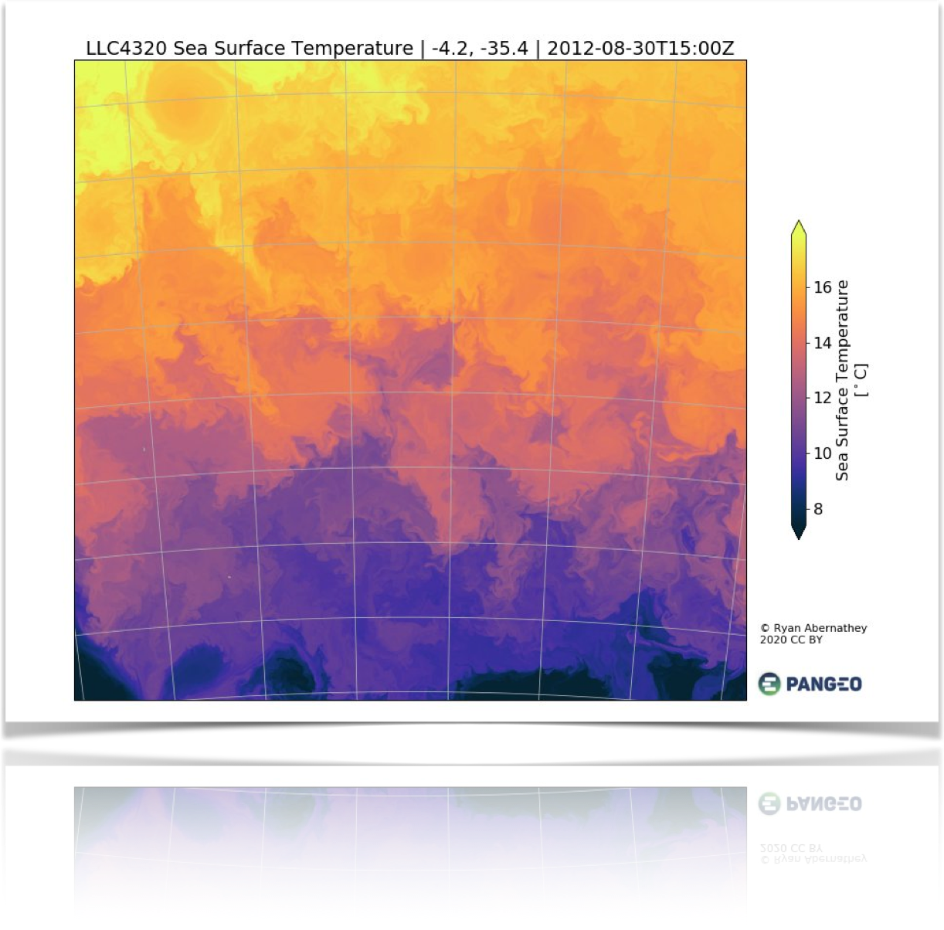
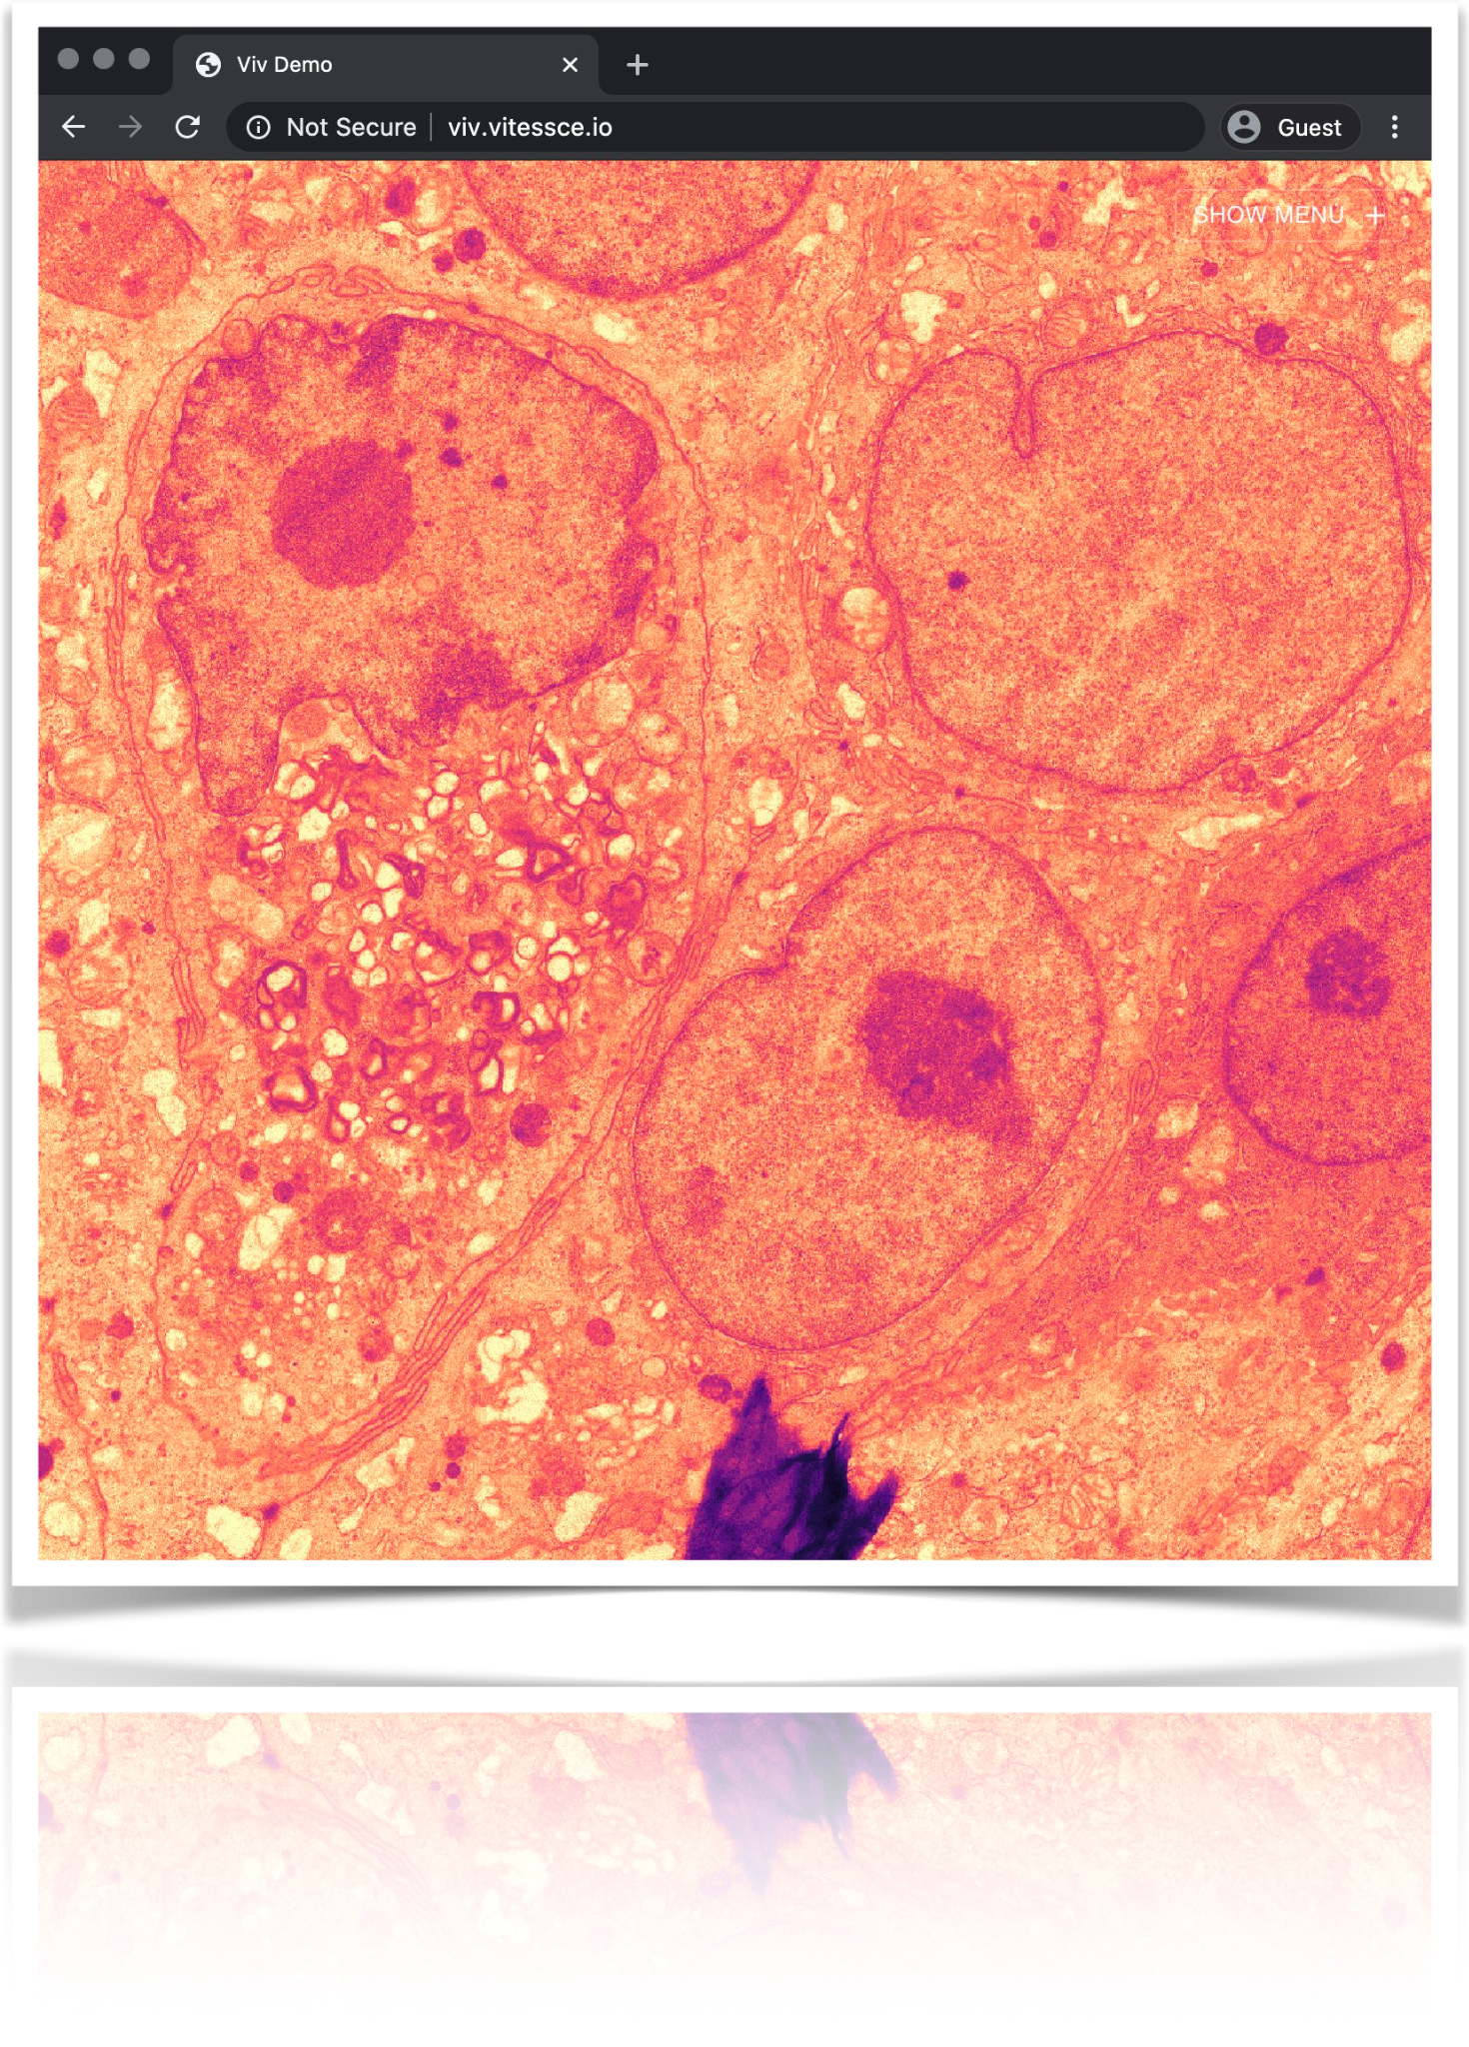
Zarr is a Generic Format For Scientific Array Data
Oceanography (~54 TB)
Microscopy (30GB)
https://twitter.com/LLC4320Bot/status/1274862822778982402
https://twitter.com/trevmanz/status/1265377097981329423
Notes:
Some 100GBs for Oceanography and 30GB for COVID-19 microscopic image.

Slide 31
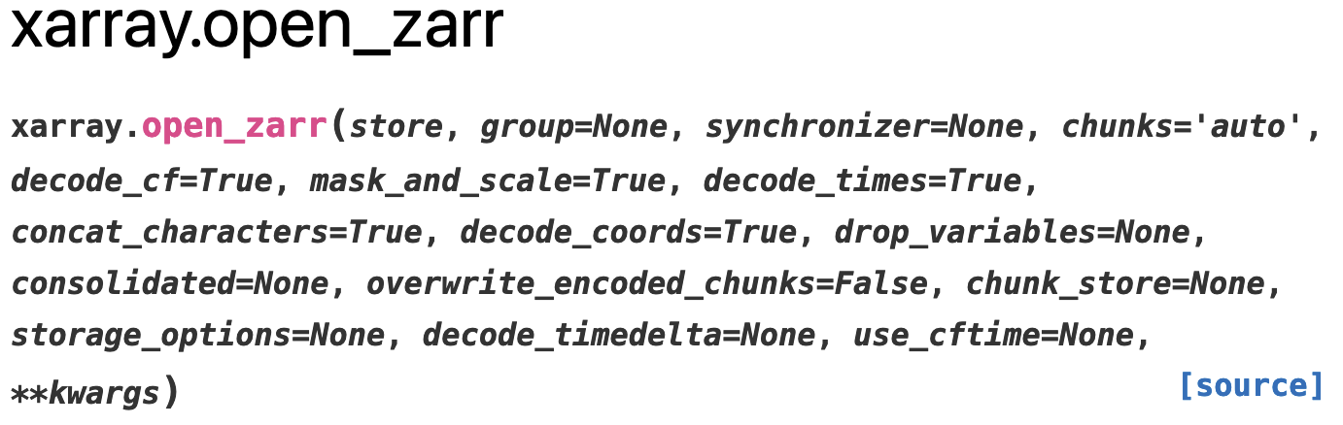
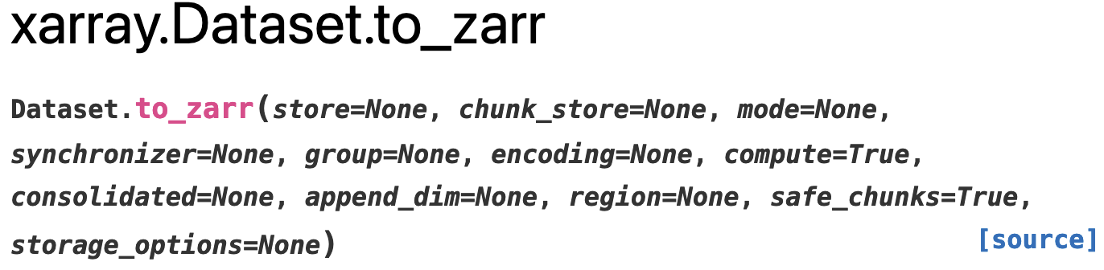
Interoperability! 🔗
~ Read and write to Zarr Stores using: Dask, Xarray, Anndata etc.

Slide 32
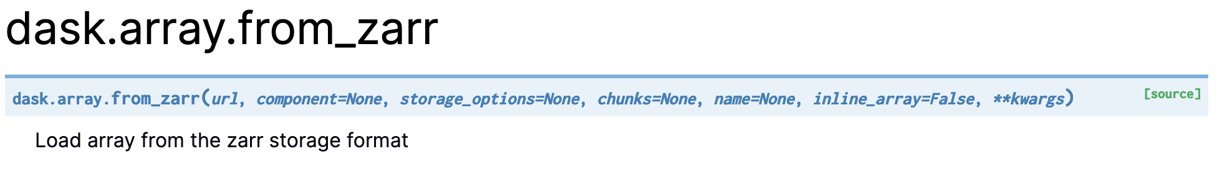
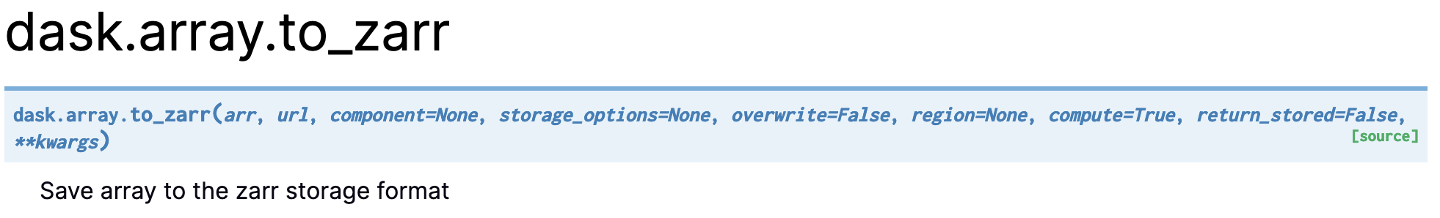
Interoperability! 🔗
~ Dask 👇🏻

Slide 33
Zarr Implementations! 😎
~ Python: https://github.com/zarr-developers/zarr-python
~ C++: https://github.com/constantinpape/z5 https://github.com/xtensor-stack/xtensor-zarr
~ NetCDF-Java: https://github.com/Unidata/netcdf-java
~ NetCDF-C: https://github.com/Unidata/netcdf-c
~ Julia: https://github.com/JuliaIO/Zarr.jl
~ Javascript: https://github.com/freeman-lab/zarr-js
~ and several more… It’s relatively easy to implement Zarr from scratch

Slide 34
Zarr Community & Future! 👨‍👩‍👧‍👦
~ What is the Zarr community and how you can join us?
~ ZEP: A community feedback process to implement changes to the Zarr spec
(https://zarr.dev/zeps/)
~ What does V3 looks like? Features?
~ Gitter: https://gitter.im/zarr-developers/community/

Slide 35


Example Zarr Cloud Datasets
CMIP6 dataset processed from ESGF NetCDF
>1 PB of data on AWS & GCS
>500K individual Zarr stores
L4 Sea Surface Temperature
One single big Zarr store 54 TB total

Slide 36
How Zarr is different? 🤔
~ Active community, rapid development
~ Implementations in several programming languages
~ Versatile data format; data conventions like GeoZarr, OME-Zarr, NCZarr
~ Interoperable with other libraries in the PyData Stack
~ Adopted by many groups → https://zarr.dev/adopters/

Slide 37
Thank you! 🙌🏻
/zarr_dev /zarr-developers https://zarr.dev/
You are welcome at our community meetings and office hours!
(https://zarr.dev/community-calls/)
(https://zarr.dev/office-hours/)

